Slide 1
Final Project Presentation
Josh Bielenberg Jake Reeves

Slide 2
Advise For Potential Ted-Talkers
Topics
Feel
Content
Title

Slide 3

Topics
Classified videos by views and comments threshold
Not Stemmed
Logistic Regression higher accuracy and easier to interpret
Important to remember that these are the meta tags.

Slide 4
Views
92% Training Accuracy 90% Testing Accuracy
Comments
92% Training Accuracy 93% Testing Accuracy
Best Tags | Worst Tags
AI Animals Conservation Garden Fellows Sanitation Failure Geology Mindfulness Pain Population TedX Europe Privacy Agriculture | Ted Botany Natural Illness Terrorism State Presentation Alternative Narcotics Tednyc Resources Dance Singer Iran Green
Best Tags | Worst Tags
AI Animals Conservation Garden Fellows Sanitation Failure Geology Mindfulness Pain Population TedX Europe Privacy Agriculture | Ted Botany Natural Illness Terrorism State Presentation Alternative Narcotics Tednyc Resources Dance Singer Iran Green
Notes:
This is despite comments and views suprisingly only having

Slide 5
53%
Correlation between views and comments

Slide 6

Feel
Multiple Linear regression with each possible rating as a tag.
Top negative coefficients: Long winded and unconvincing
Top positive coefficients: Ok and confusing
Had to remove informative because of VIF.
Regressed on number of comments but low accuracy (~50%)

Slide 7
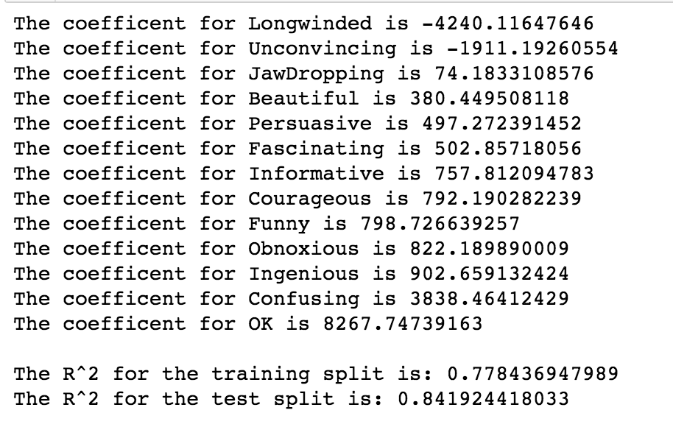

Slide 8
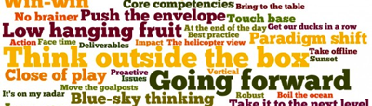
Content
Sentiment Analysis
Best/worst topics or words?

Slide 9
Analyzing transcript data
How do we define a successful video?
above/below median
outlier status
How to get what we want...
nltk sentiment analysis
naive bayes / logistic regression
Simple word counts – not so successful

Slide 10
What works best?
Testing accuracy with Naive Bayes
Based on median: 62%
Based on outlier: 71%
Testing accuracy with Logistic Regression
Based on median: 59%
Based on outlier: 87%
Hey, that’s not half bad...

Slide 11
But, what is realistic?
NOT outlier analysis
Too few samples
Too many other factors go into making a video viral
Good words: shape, Britain, multiple, set, anything.
Bad words: interest, summer, individual, waste, give.

Slide 12
But, what is realistic?
MEDIAN ANALYSIS
62% predictive power with Naïve Bayes
MUCH more reasonable positive/negative words
Faster – O(log(n)) of Bayes vs. O(n) of LR

Slide 13
So, you want to be above average?
Best words:
Protest, sleep, hate, sorry, direct, school, affect, voice, govern, rise, prize, risk
Worst words:
Kitchen, microscope, tend, lose, fun, folk
BASICALLY
Use buzz words
People want to hear about things directly affecting them (e.g. protest, school, govern, risk)
Do NOT discuss boring stuff (e.g. microscope, kitchen)

Slide 14

Title
More sentiment analysis
What “hooks” a viewer?
What deters a viewer?

Slide 15
Boring details
MEDIAN BASED
60% testing accuracy with both Bayes and LR
Reasonable word set
OUTLIER BASED
92% testing accuracy?????
I’ll believe it when I see it…
Roughly the same word set as median-based analysis

Slide 16
What to/not to put in your title
PUT THIS!
Protest
Trickle-down
Jihad
Earth-like
Fast-grow
Asia
BUZZWORDS!
BUT NOT THIS…
…
1994
404
Afghanistan
Africa
African
BORING_WORDS

Slide 17
BUZZWORDS
TOP 5 TED TALKS
Do schools kill creativity?
Your body language may shape who you are
How great leaders inspire action
The power of vulnerability
10 things you don’t know about orgasm
BUZZWORD!

Slide 18
Talk about current, socially-relevant topics.
BASICALLY

Slide 19
BUZZWORDS
BASICALLY

Slide 20
Leave the science-talk for the research paper. Let’s be honest… this is sexy science.
BASICALLY

